Slide 1
YouTube Prediction
By Spencer Negri

Slide 2
Who is our user?
A millenial looking for video idea recommendations that will become popular
What is popular?
High numbers of likes and views
Given a user who wants to make videos about a certain topic/topics, our application will tell them if these topics will get views/likes or no

Slide 3
Our Idea
Collect data regarding the frequency of certain aspects of existing videos (views, likes, dislikes, etc.)
User will have interests that he/she wants to make a video about in order to be famous (DIY, makeup, costumes, etc.)
Create a report for the user informing them of how popular their video is expected to be based on previous videos of the same topics

Slide 4






Users
Users interact through front end
Scraper.py
Load Balancer
Cache
My Component
My Component creating/storing, retrieving/updating

Slide 5
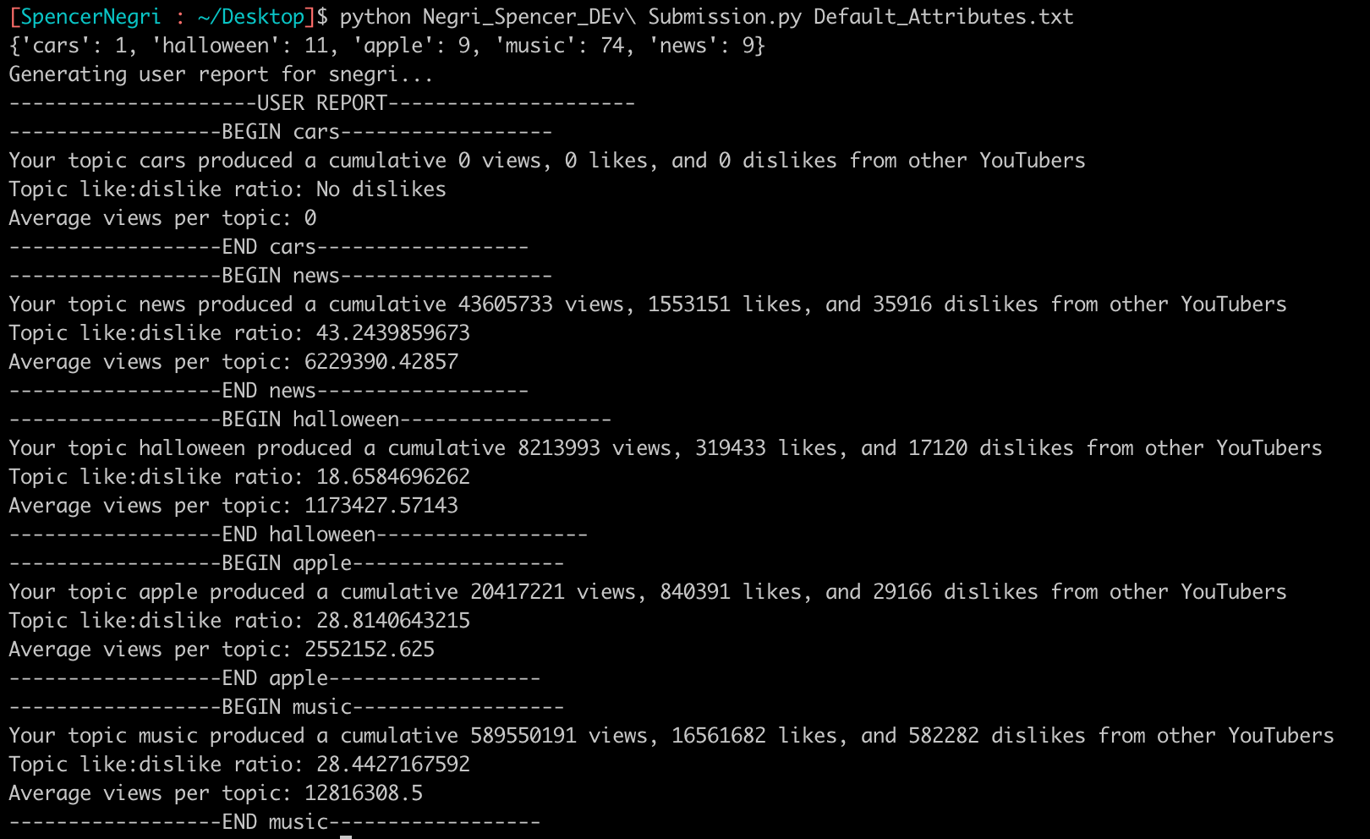
Component Demo

Slide 6
Things Not Shown
My component creates the class structure for our application
Creates User, Topic, Video
Creates interactions between classes
Easier management/manipulation of data
Scrapes "database" or csv for data necessary to predict a video's popularity

Slide 7
What I Would Do Next
Modify my code to compile a list of keywords that resulted in the most views
Suggest this to the user
Given a topic with a good rating (from our future software), suggest specific videos to the user of similar topics
Could accomplish this using the video list my code compiles

